Slide 1
IT Ticket Analysis Aditya Bhootra

Slide 2
Introduction
The aim of the project is to analyzing the IT support ticket management system to understand the performance of IT agents.
Assessing the efficiency of ticket resolution, and the satisfaction levels of employees.
The ultimate goal is to make informed staffing decisions, including hiring, firing, and training, to enhance overall service quality and team performance.

Slide 3
Data Overview
Total sheets:- 2 ( Tickets and IT Agents sheet).
Total number of tickets raised:- 97498
Total no of IT agents:- 50
Time Span of data:- 2016 to 2020
Categorical columns:- 16

Slide 4
Data Cleaning and Preparation
There were no missing values in the data.
However, there were some spelling mistakes like ‘Unclasified’ and ‘Unasigned’.
Moreover, both the severity type and severity key were in the same column( joined with a ‘-’). Same with the Priority column
Used text to columns feature to separate the values.
Used ‘Find and Replace’ feature to correct the spelling mistakes.
Then also added weekday and year column in the dataset from the fecha column.
In the IT agents sheet, calculated DOB nad then calculated current age of all the agents.
Used XLOOKUP to add age column in Tickets sheet.

Slide 5
Analysis and Insights
System category has received a total of 39002 tickets which is the maximum among all categories.
The least amount of tickets has been received from Hardware category which is 9733.
It is crucial to understand distribution of ticket categories so that we can decide that which category need more improvement

Slide 6
Analysis and Insights
Maximum no of tickets were held by agent id 48 which is 2027 tickets.
Minimum no of tickets were held by agent id 13 which is 1856 tickets.
Understanding of ticket distribution among IT agents is necessary to measure the performance of IT agents.

Slide 7
Analysis and Insights
The above pivot table shows the count of tickets for each issue type.
Count of tickets raised for IT error were 24278.
Count of tickets raised for IT request is 73220.
Understanding of ticket distribution among issue types is crucial to know that for which issue types , more tickets are raised.

Slide 8
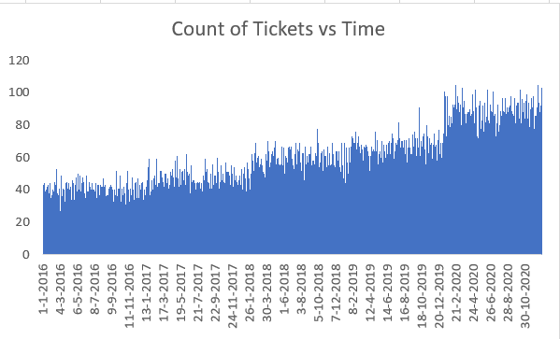
Analysis and Insights
The above graph shows that volume of tickets have gradually increased from 2016 to 2020.
Maximum no of tickets raised on any day were 105 on 16 Feb 2020 and 20 Feb 2020.
Minimum no of tickets raised on any day were 17 on 17 Nov 2016.

Slide 9
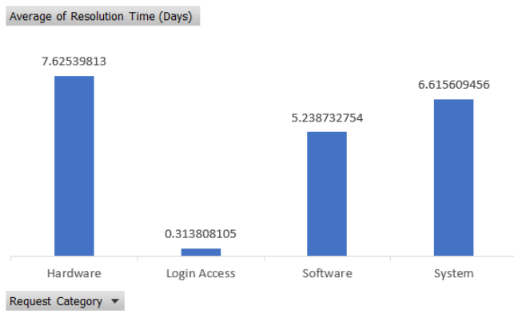
Analysis and Insights
Tickets raised from Hardware category takes the most to resolve.
Ticket raised from Login Access category gets resolved in just 0.3 days.
Understanding of resolution time of different request category is necessary to understand which request category is taking more time to get resolved.

Slide 10
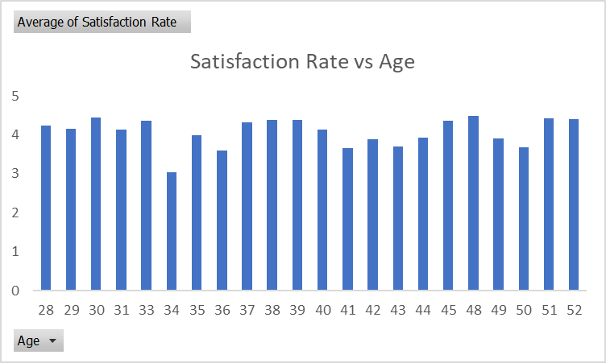
Analysis and Insights
Consistently High Satisfaction (Ages 28-38): The satisfaction rate remains relatively stable and high in the age range of 28-38.
Slight Dip in Mid-Age Group (Ages 39-43): There is a noticeable dip in satisfaction levels around ages 39-43.
Satisfaction Rebounds (Ages 44-52): The satisfaction rate recovers and stays consistent towards the upper age bracket (44-52).

Slide 11
Analysis and Insights
Steady Improvement: The satisfaction rate has consistently increased year over year from 2016 to 2020.
Significant Jump: The most noticeable rise in satisfaction occurred between 2016 and 2017.
Peak in 2020: 2020 recorded the highest satisfaction rate, suggesting successful efforts to boost employee morale.

Slide 12
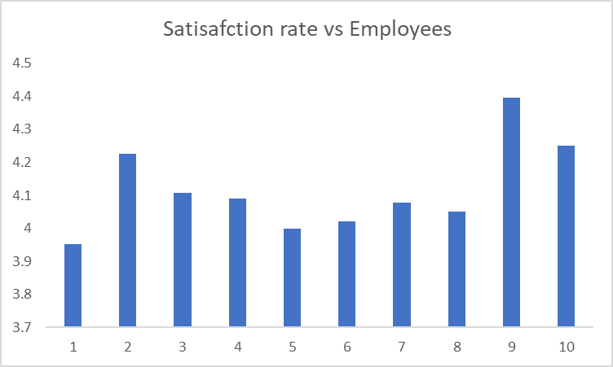
Analysis and Insights
The data has a total of 2000 employees, but we are only analysing performance of 10 employees.
The peak satisfaction rate is given by the employee no 9 which is close to 4.4.
The lowest satisfaction rate is given by no. 1 which is close to 3.9.
The satisfaction rate of the whole data ranges from 3.9 to 4.5.

Slide 13
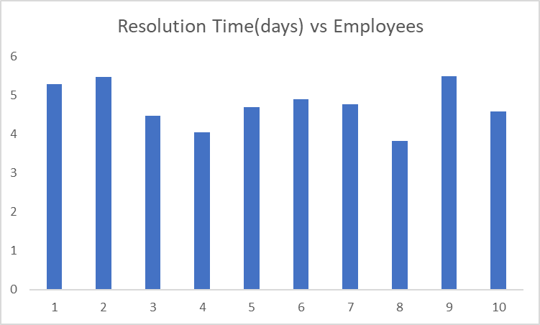
Analysis and Insights
Issues of employee no. 4 got resolved on just less than 4 days on an average.
While for Id no. 2 and 9 , it took more than 5 days.

Slide 14
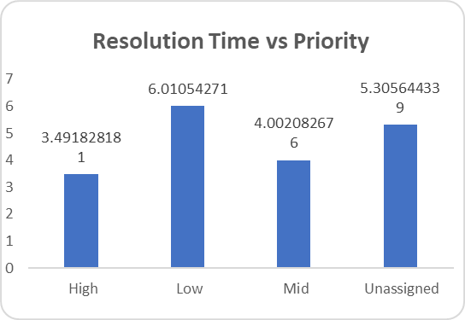
Analysis and Insights
This graph shows the resolution time of different priorities.
Unassigned priority tickets are taking less time to resolve than low priority tickets.
High Priority tickets get resolved in just 3.49 days.
It is crucial to understand that whether tickets are being resolved according to priorities or not.

Slide 15
Analysis and Insights
System-related requests dominate the ticket count with 39,002 tickets.
Login Access issues are the second highest, with 29,193 tickets.
Software requests are substantial but lower than System and Login Access.
Hardware requests are the least frequent, with only 9,733 tickets.

Slide 16
Analysis and Insights
Most tickets (25,071) are resolved within 0 days.
Resolution times of 1 to 7 days also show a high ticket count, with a gradual decline.
Resolution times beyond 10 days are minimal.
Resolution efficiency decreases as time increases.

Slide 17
Analysis and Insights
Normal severity tickets are the most common, with 88,656 tickets.
Major severity tickets are relatively few, with only 4,836.
Minor, Unclassified, and Urgent tickets have very low counts, with only 2,258 Minor, 356 Unclassified, and 1,392 Urgent tickets.

Slide 18
Strategic Recommendations
Hiring more agents can be one option.
The current agent-to-ticket ratio is approx 1912 tickets per agent over four years from 2016-2020.
It seems that the resolution time is high due to agent overload, so hiring more agents can be the solution.
Hiring more agents incurs salary costs, benefits, and overhead expenses.
This could reduce the workload for existing agents, leading to faster ticket resolution times and more satisfaction rate as resolution time has increased.

Slide 19
Strategic Recommendations
Another option might be to improve training programs.
We should focus on agents with high resolution times and low satisfaction scores.
We found an insight in the analytics section(9th slide) that agents 19,22,25,28,3,22, 7 have resolution time>=5 days and satisfaction rate<=4.
If their performance is due to a lack of training then improving training could be a cost-effective solution.
Better-trained agents can resolve tickets faster and more accurately, improving satisfaction scores and lowering resolution times.

Slide 20
Strategic Recommendations
Upgrading ticket management software system is another good alternative.
Slow resolution times that are caused by inefficiencies in the current system can be improved by upgrading the system.
Software upgrades can be expensive (licensing, implementation, training on new software).
New software might automate certain tasks, track issues better, and improve the overall efficiency of ticket handling.

Slide 21
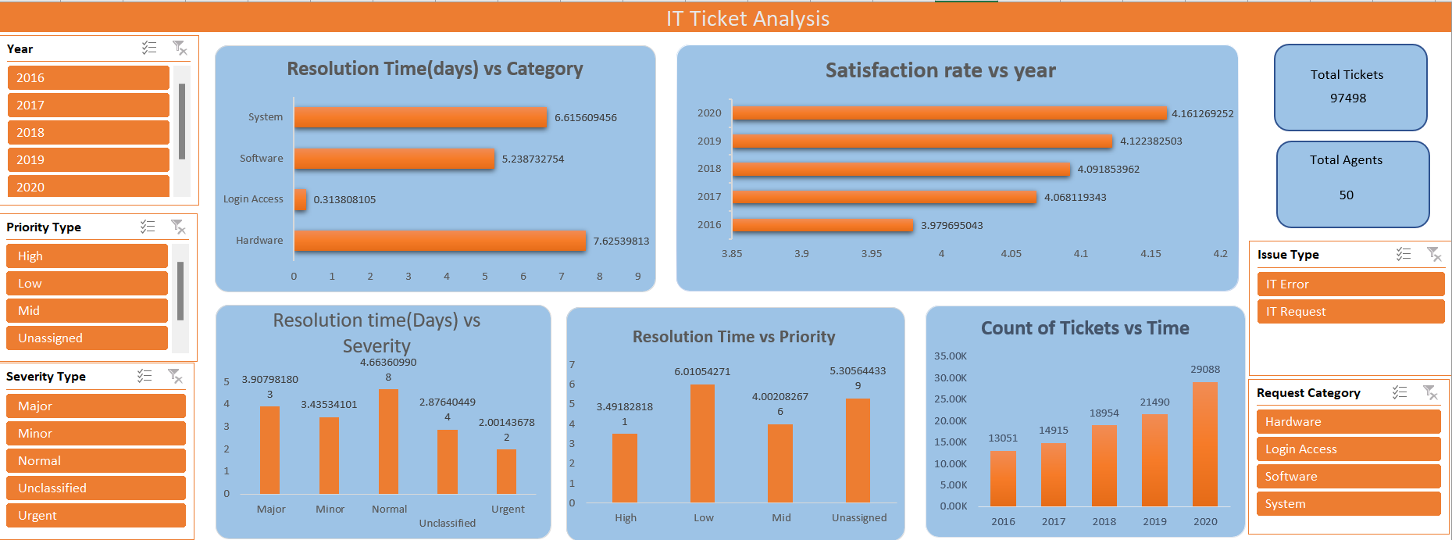
Dashboard

Slide 22
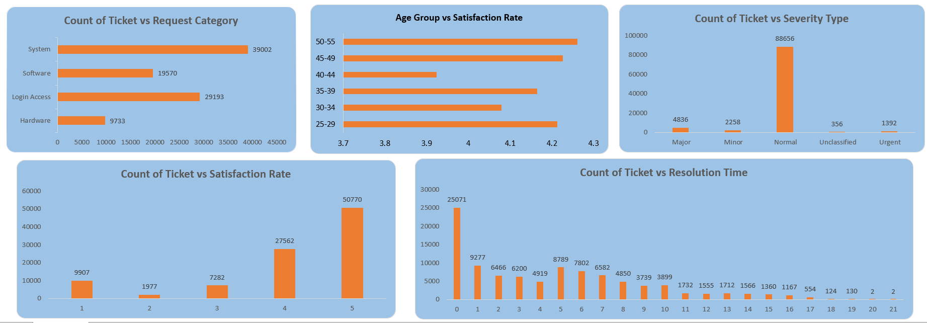
Dashboard

Slide 23
Conclusion
In this analysis, we have uncovered key insights regarding the performance of the IT support team. We observed a increasing trend in ticket volume and identified areas where agent performance can be optimized, particularly through training programs for agents with lower satisfaction scores and longer resolution times.
Recommendations:
Prioritize targeted training for underperforming agents.
Upgrade software tools to reduce resolution times and improve user experience.
By addressing these areas, the IT support team will not only improve operational efficiency but also enhance the overall satisfaction of employees, driving better long-term performance.

